Slide 1


Care Kits
The Proven Transition-of-Care
Solution

Slide 2
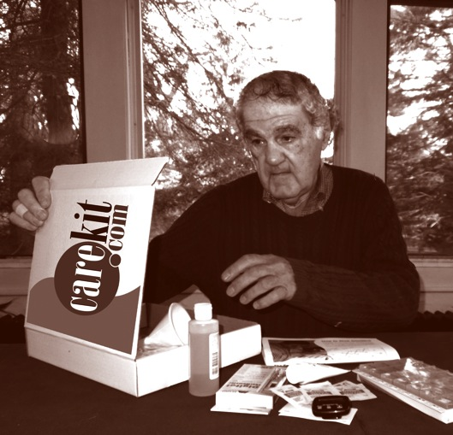
Care Kits Drive Results! Improve Care & Drive Down Costs
Care Kits Provide a Key role in Successful Transitions of Care
Provides the curriculum, tools and devices for successful patient engagement
  Dramatically reduces re-admissions rates up to 100%
  Increases Patient Satisfaction Scores
  Creates standardized patient care
  Increases Provider Referrals & Enrollees – Sets your organization apart
  Enhances Productivity: Fewer & shorter patient visits
  Produces a successful, independent patient

Slide 3
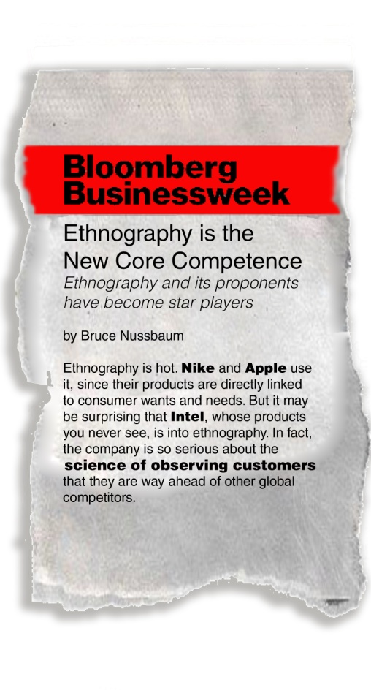
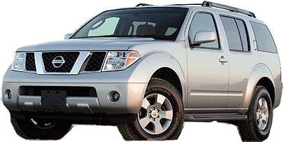
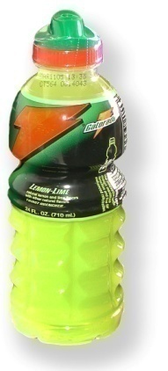
Why Care Kits Work: Based on Ethnographic Research
We use the research techniques of anthropology:
We go into users’ homes, workplaces
and communities to watch them in context
We observe what works and
what obstacles block success—
from the point of view of the patient
noting what people say
and what they do are different.
The Consumer products industry has been doing this for 30 years.
After 10 years of flat sales, the ethnographically redesigned
Pathfinder increased sales
100%
Despite being a
mature product,
the redesigned
Gatorade bottle
increased sales
23%
“I would never bring out
a new product without
doing ethnography.”
vvvvvvvShane Wall
VP New Product Development, Intel
Notes:
The SelfCareKits include clinical materials which have been transformed to cause participant engagement and behavior change and again we stress that the programs promotes active participation, not passive.

Slide 4
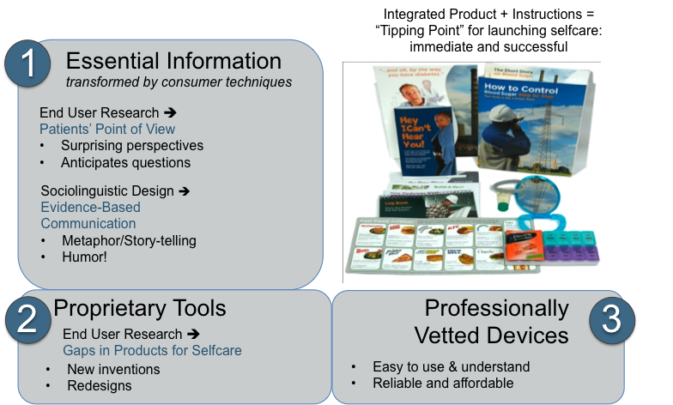
Care Kits are Unique: Three Essential Pieces

Slide 5
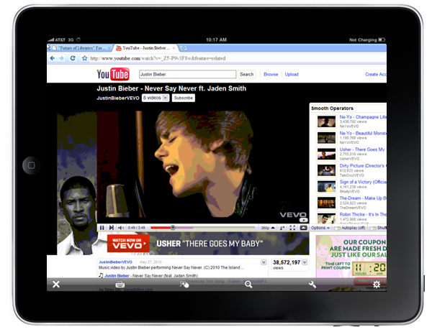
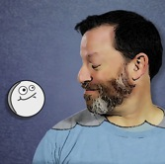

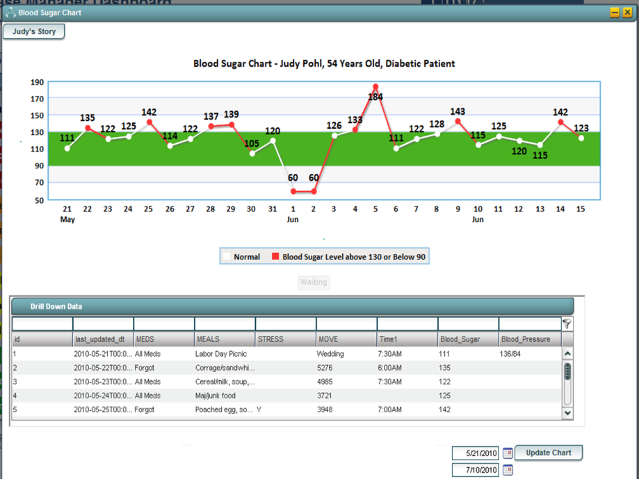

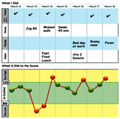
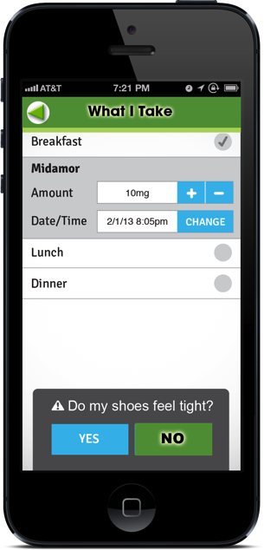
Online Access: Maintenance and Additional Content
Providers & patients can go online for additional content and tools to maintain the program the long term
How Medicine
Works
The Impact Analyzer
Vent Your Story
In Development:
13 Animations
2 Videos

Slide 6
How to Use Care Kits Supports Your People
Care Kits are given to patients as they transition to home care:
  Step 1: Select from one of 32 conditions
    Most often used: Heart Failure, Diabetes, COPD, Safety & Mobility Kits, and Multiple Condition Care Kits
  Step 2: Deliver to the Patient
    Newly Diagnosed: admission visit or next visit
    Recurring Non-Compliant Patient: as needed
  Step 3: Integrate With Your Care Plan
    Care Kits meet all “standards of care”
    Early on: Review big picture
    Ongoing: help patient meet the goals by following the Care Kit curriculum
  Step 4: Watch Your Patient Improve
    Care Kits promote self-care and independence
    Leave patient with the tools for ongoing health management

Slide 7
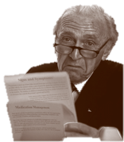

Does It Make a Difference? Outcomes & Results
Rush University Medical Center compared instructions approved by their Patient Education Committee, to Care Kits.
For 6 months, they called each patient 1 week post discharge:
“Were you able to carry out your self care without asking for help?”
• “How satisfied are you with the selfcare materials?”
RUSH’S PAPER
4%
CARE KITS
92%
RUSH’S
PAPER
35%
CARE KITS
100%
ASTHMA More than doubled medication adherence, eliminated readmissions and reduced ER use by 72% vs. American Lung Assn handouts
Q:
Did the Care Kit
help you manage
your condition?
Virtua New Jersey Medical Center
YES
Heart Failure 97.3%
Hypertension 94.9%
Diabetes & Pre-diabetes 93.6%
Asthma 92.5%
Coronary Artery Disease 100%
Post Surgical 100%
HYPERTENSION 88% in target range after 6 months vs. 12% after home visits+phone coaching
Suburban Chicago employee wellness program
University
of Pittsburgh
FIVE-YEAR AVERAGE
34% better than
national 5-year
average
HEART FAILURE Reduced readmissions by 74%; increased regimen adherence by 300-500%
vs. standard paper, home visit and phone coaching
Multiple studies WI, IL, KY, MI, and others

Slide 8
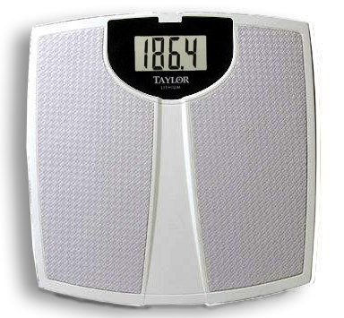
Does It Make a Difference? Outcomes & Results
BEFORE AFTER
Readmission Rates
30-day Heart Failure
Before After
REDUCED BY
38%
54%
34%
74%
72%
73%
38%
100%
St. Joseph, Lexington KY
St. Joseph, Elgin IL
NWC, Arlington Hts. IL
DRG 127 ONLY
NWC, Arlington Hts. IL
ALL CHF-RELATED DRGs
Aurora, Milwaukee WI
Great Plains, Elk City OK
VA, Ann Arbor MI (90 Days)
Mercy Hospital, Chicago IL
6.4% 4.0% 38%
16.7% 7.7% 54%
13.2% 8.7% 34%
23.4% 6.9% 74%
22.2% 6.3% 72%
8.6% 2.2% 73%
54.5% 33.3% 38%
At Mercy only: N = insufficient for highest level of statistical significance, but indicative, especially given overall trend
>28% 0%

Slide 9
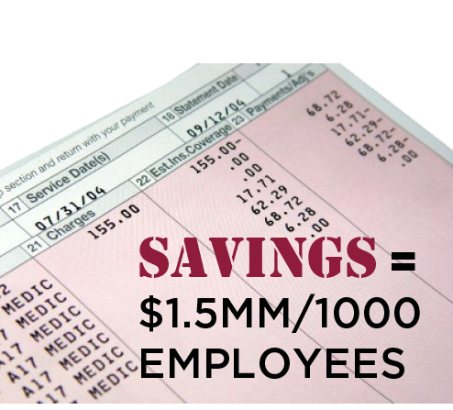
Case Study: Employee Population, Las Vegas NV
Data Presented to the Nevada State Legislature
After 24 months, for 712 participants, total
medical costs were 23% lower than baseline year.
Blood pressure, cholesterol, and blood sugar improved more than 85%
Emergency Room visits decreased by 16%
and hospital days decreased by 54%
There were substantial reductions in imaging
services (-35%), procedure services (-10%) and prescription costs per member (-18%)
The net savings exceeded $56 PMPM =
$1.5 MM / 1000 members
Members had 30% lower out-of-pocket cost compared to the alternate PPO plan”
J Reeves, Medical Director
Well Portal Benefit Plan

Slide 10




Proven Track Record It Works for Providers
“I used to spend a lot of time explaining things. But my patients
always came back with the same misunderstandings.
With Care Kits™they get it. We can have
a real conversation–make plans and move forward.’
Robert Fanning, MD, Director, Cardiovascular, University of West Virginia
“The first thing you notice about using the Care Kits is that the phones go dead. The kits have anticipated all the patients’ questions.” Pat Sloman, RN CCM Oncology Department Chief
Kaiser Permanente
Riverside, CA
  “We‘ve used the tools for five years with five chronic conditions.
  Satisfaction scores have been 97 to 100%.”
  Dr. S. Ramalingam, Medical Director University of Pittsburgh
“Our readmissions were over 28%. Sixty days into a trial with [Care Kits] we had no readmits for Heart Failure.”
Carla Campbell CNO, Mercy Hospital and Medical Center, Chicago
SOME CURRENT CUSTOMERS
University of Pittsburgh Health Plan
Kaiser Permanente
Hotel and Restaurant Workers Union
80+ Home Care Agencies
wellPORTAL Wellness
University of Oklahoma Medical Center
Greater Baltimore Medical Center
Northwest Community Hospital
Provena Hospitals
University of Tennessee Hospital
Palmetto Health Plan ACO
INFORMed TPAdministrator

Slide 11

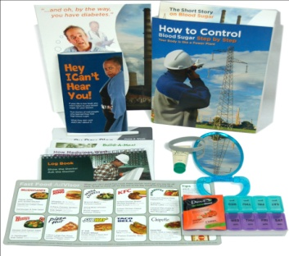
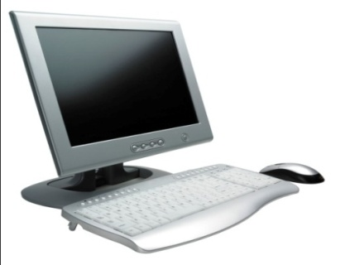


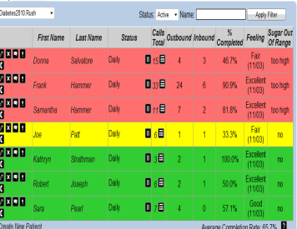
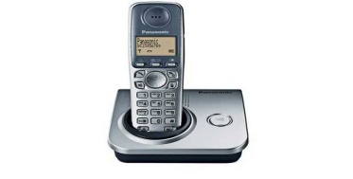
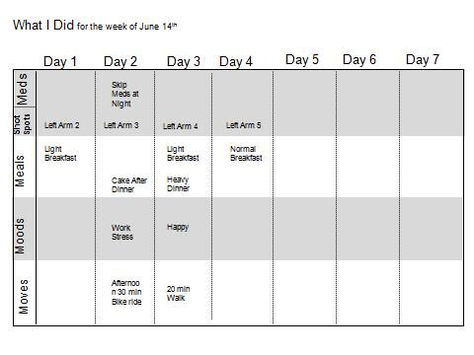
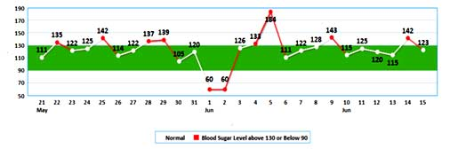

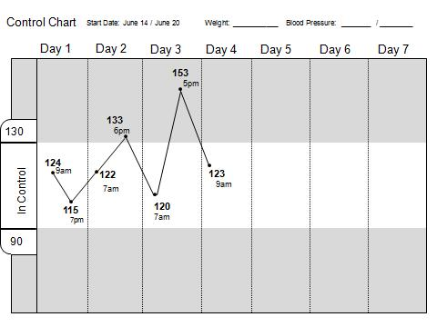
Combine Care Kit With Enhanced Connections: IVR & Web
CARE KITS ACTIVE CONNECTIONS ANALYTICS OUTREACH
Care Kits™
Provide the Framework: Curriculum, Tools and Devices
Telephone IVR and Web Connections Improve Patient Connectivity & the
Patient Experience. Scripts and Engagement are Based on Care Kit Curriculum
Dashboard Analytics Improve Timely Care – Either In-Home or Via Telephone or e-mail.
Automation Allows Real-Time Monitoring and Personalized, Need-
Based Contacts.
Tracking systems, endorsed by the Juran
Quality Institute, allow both patient and
provider to see cause and effect at a glance:
Discovery learning for long-term behavior change!

Slide 12


Contact Information
Questions or comments about SelfCareKits?
Carol Outland RN MSN - Clinical Content Director
O: 847-850-7500 ext 117
M: 708-267-2646
coutland@carekit.com
Michael Weiss – President
O: 847-850-7500
M: 312-498-2603
mweiss@carekit.com
Shirley Grey RN MSN – EVP Sales & Customer Service
O: 847-850-7500 ext 103
M: 847-910-3552
sgrey@carekit.com
Judy Farah RN – Operations Director
O: 847-850-7500 ext 106
M: 708-826-4017
jffarah@carekit.com
Sylvia Aruffo, PhD – Consumer Content Officer
O: 847-850-7500 ext 101
M: 847-910-3549
saruffo@carekit.com

